Slide 1


Hope to Skills
Lecture# 13
Irfan Malik, Dr. Sheraz Naseer

Slide 2
Agenda
Recap
Descriptive Statistics
Mean, Median, Mode
Interquartile range
Correlation Analysis
Data Visualization
Quiz

Slide 3
Descriptive Statistics
Descriptive statistics is the branch of statistics that focuses on summarizing and describing the main features/Attributes/Variables of a dataset.

Slide 4
Mean
The mean is the average of a set of numbers.
Calculated by summing all the numbers in the dataset and dividing by the total count.
Formula: Mean = (Sum of all numbers) / (Total count)
Example: For the dataset [5, 7, 10, 12, 15], the mean is (5 + 7 + 10 + 12 + 15) / 5 = 9.8.
Sensitive to outliers
Example: For the dataset [5, 7, 10, 12, 150], the mean is (5 + 7 + 10 + 12 + 150) / 5 = 36.8.

Slide 5
Median
The median is the middle value in a sorted dataset.
If the dataset has an odd number of values, the median is the middle number.
If the dataset has an even number of values, the median is the average of the two middle numbers.
Example 1: For the dataset [3, 5, 6, 8, 9], the median is 6.
Example 2: For the dataset [2, 4, 6, 8], the median is (4 + 6) / 2 = 5.

Slide 6
Mode
The mode is the value that appears most frequently in a dataset.
A dataset can have one mode, more than one mode (multimodal), or no mode (no value repeats).
Example 1: For the dataset [3, 4, 4, 6, 8], the mode is 4.
Example 2: For the dataset [1, 2, 3, 4, 5], there is no mode.

Slide 7
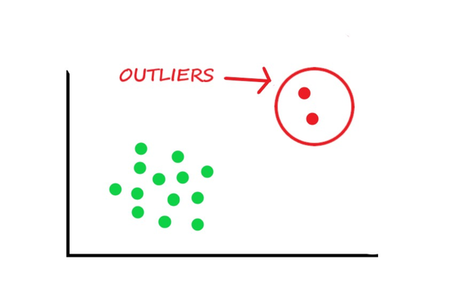
Outliers

Slide 8
Question ?
You have a Data based on the opinion of 1 million people how can you identify that their opinion is totally different (largely dispersed) from each other or they have closely related (less dispersed) opinion about a certain thing.
How can you identify the Outlier ?

Slide 9
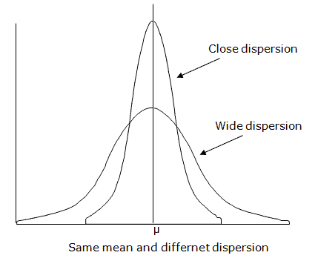
Why we care about Dispersion?
Increased difficulty in capturing patterns.
Increased risk of overfitting.
Reduced predictive accuracy.
Impact on outlier handling

Slide 10
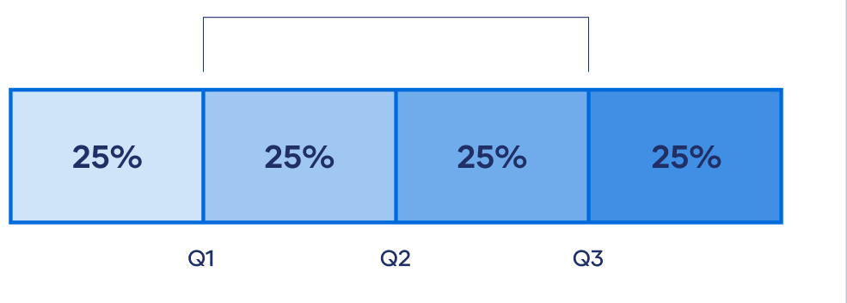
Quartiles
Quartiles:Quartiles divide a dataset into four equal parts, each representing a quarter (25%) of the data.

Slide 11
Quartiles and Interquartile Range (IQR)
The first quartile (Q1) is the value below which 25% of the data falls.
The first quartile (Q2) is the value below which 50% of the data falls. It's actually Median.
The third quartile (Q3) is the value below which 75% of the data falls.

Slide 12
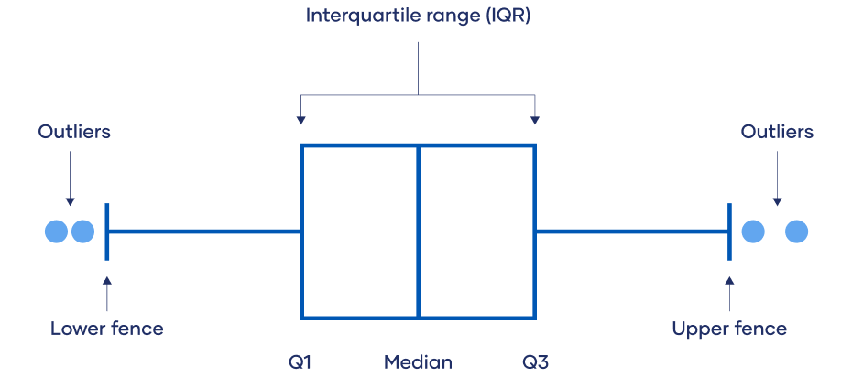
Interquartile Range (IQR)

Slide 13
Finding Quartiles
To find the quartiles, first, arrange the dataset in ascending order.
If the dataset has an odd number of values, the median is the second quartile (Q2).
If the dataset has an even number of values, calculate the median of the lower and upper halves to find Q2.

Slide 14
Interquartile Range (IQR)
The IQR represents the difference between the first and third quartiles(Q1 and Q3).
It indicates the spread of the middle 50% of the data.
Formula: IQR = Q3 - Q1

Slide 15
Interpretation of the IQR
The IQR provides information about the spread and variability of the data.
A larger IQR indicates a greater spread and more variability in the dataset.
Conversely, a smaller IQR suggests a less spread and less variability.

Slide 16
Applications
The IQR is widely used in various fields, including economics, healthcare, and social sciences.
It helps compare and analyze data distributions, identify abnormal data points, and detect potential patterns or trends.

Slide 17
Correlation Analysis
Correlation analysis is used to determine the relationship between two or more variables in a dataset. It helps us understand how changes in one variable affect another variable.

Slide 18
Interpreting Correlation Values
Correlation values close to +1 or -1 indicate a strong relationship.
Correlation values close to 0 indicate a weak or no relationship.
The magnitude of the correlation value represents the strength of the relationship.

Slide 19
Examples of Interpretation:
Correlation coefficient = +0.9:
There is a strong positive relationship between variables.
As one variable increases, the other variable tends to increase proportionally.
Correlation coefficient = -0.6:
There is a moderate negative relationship between variables.
As one variable increases, the other variable tends to decrease, but not as strongly as in a strong negative correlation.
Correlation coefficient = +0.2:
There is a weak positive relationship between variables.
The variables are positively related, but the relationship is not strong.

Slide 20
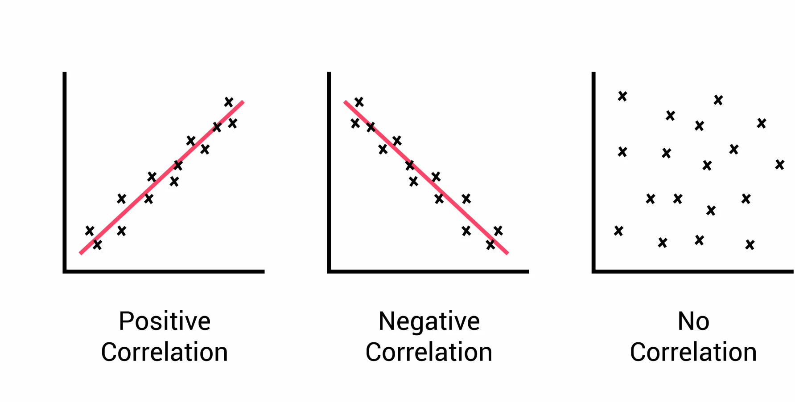
Correlation Analysis

Slide 21
Use of correlation analysis
Predictive modeling
Feature selection
Data exploration

Slide 22
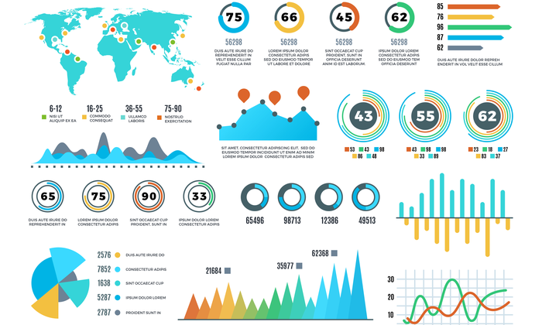
Data Visualization
Data visualization is the graphical representation of data and information. It involves creating visual elements such as charts, graphs, and maps to help people understand complex data patterns.

Slide 23
Examples of data visualizations
Bar chart
Line graph
Scatter plot
Pie chart

Slide 24
Lets move to Google collab

